Slide 1

CHAPTER 1
What Is Sociology?

Slide 2
Learning Objectives (1 of 2)
Learn what sociology covers as a field and how everyday topics are shaped by social and historical forces.
Recognize that sociology involves not only acquiring knowledge but also developing a sociological imagination.
Learn how sociology originated and understand the significance of the intellectual contributions of early sociologists.

Slide 3
Learning Objectives (2 of 2)
Be able to identify some of the leading theorists and the concepts they contributed to sociology.
Learn the different theoretical approaches modern sociologists bring to the field.
Understand how adopting a sociological perspective allows us to develop a richer understanding of ourselves and the world.

Slide 4
What Is Sociology?
The COVID-19 pandemic of 2020 caused drastic shifts in many areas of life, including academia.
Students, teachers, and parents were all suddenly forced to take note of and reevaluate their understandings of everyday life.
The sociologist C. Wright Mills would have called this an example of average people using their sociological imagination.

Slide 5
The Sociological Imagination
Sociological imagination: The application of imaginative thought to the asking and answering of sociological questions. Someone using the sociological imagination “thinks himself away” from the familiar routines of daily life.
Social structure: The underlying regularities or patterns in how people behave in their relationships with one another.

Slide 6
1.1 Basic Concepts

Slide 7
Social Construction
Social construction: An idea or practice that a group of people agree exists. It is maintained over time by people taking its existence for granted.
Gender is one such construction.
People interact with babies differently based on their sex.
These interactions teach children what is considered traditionally “masculine” and “feminine,” and they incorporate these norms into their behavior as they start to occupy the role of “boy” or “girl.”

Slide 8
Social Order
There are many instances of social order that make society run smoothly, such as students quietly sitting in a classroom during a lecture.
Sociologists have offered several explanations for social order:
It is the most rational choice.
It is the result of norms internalized through socialization.
It is a product of beliefs and values.
We will explore the second explanation further.

Slide 9
Socialization
Socialization: The social processes through which children develop an awareness of social norms and values and achieve a distinct sense of self.
Although socialization processes are particularly significant in infancy and childhood, they continue to some degree throughout life.
No individuals are immune from the reactions of others around them, which influence and modify their behavior at all phases of the life course.

Slide 10
Agency and Structure
The sociological imagination can be deterministic in the way it pushes us to see that our lives are determined by social roles, gender, race, and class.
Sociologists look at the probabilities that people will end up in certain living situations based on certain characteristics.
At the same time, they acknowledge that individuals with free will can have their own impact within these constraints.

Slide 11
Social Change
Sociologists ask how people live through the social transformations of their time.
Alexis de Tocqueville’s 1835 study, Democracy in America, viewed the U.S. as a nation of joiners in which people are involved in many groups and activities.
Are today’s Americans are less involved in public-spirited activities than in the past?

Slide 12
Social Change
In recent years, sociologists have focused on the rise of the Internet and its transformation of everyday life.
During the COVID-19 pandemic, many of these changes came together to form a new social reality.

Slide 13
1.2 The Development of Sociological Thinking

Slide 14
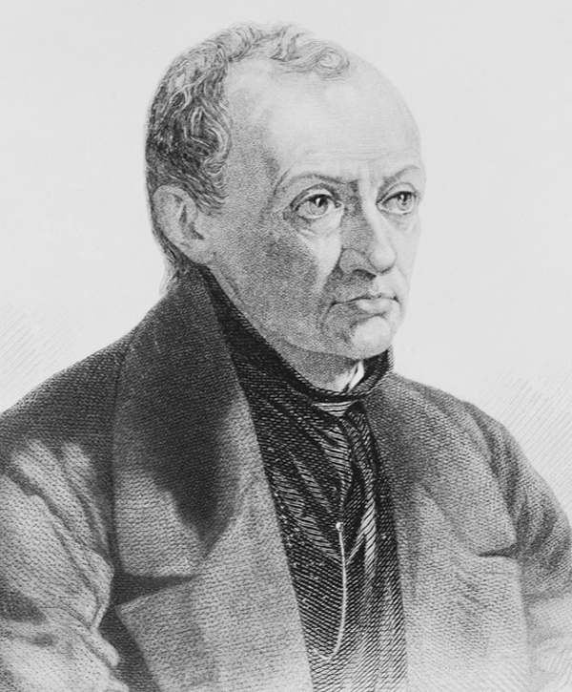
Auguste Comte
Auguste Comte believed that the scientific method could be applied to the study of human behavior and society, and that this new field could produce knowledge of society based on scientific evidence.
He initially called the subject social physics.

Slide 15
Sociology as a Science
Comte felt that sociology should contribute to the welfare of humanity by using science to predict and control human behavior.
His ideas about social planning were predicated on an understanding that society and the social order are not natural, but rather are constructed by individuals.

Slide 16
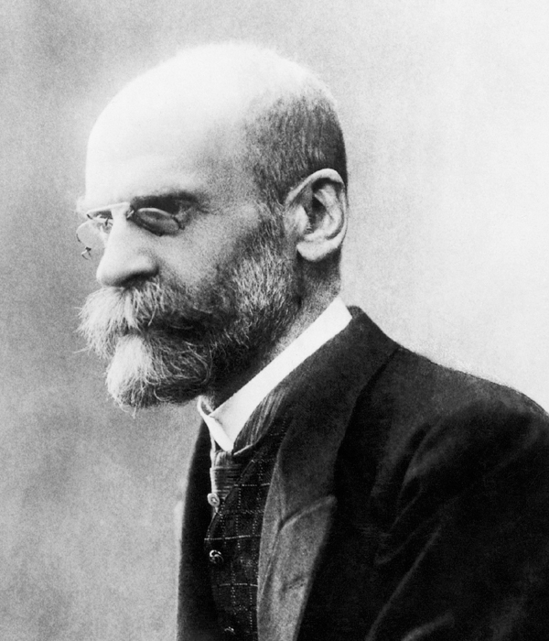
Émile Durkheim
Social facts: According to Émile Durkheim, the aspects of social life that shape our actions as individuals.
Durkheim believed that social facts could be studied scientifically, and that social life could be analyzed like any object or event in nature.

Slide 17
Organic Solidarity
Durkheim saw society as an organism comprised of specialized parts that needed to work in harmony for the whole structure to endure.
Organic solidarity: According to Durkheim, the social cohesion that results from the various parts of a society functioning as an integrated whole.
Durkheim argued that the continuation of a society depends on cooperation, which presumes a general consensus among its members regarding basic values and customs.

Slide 18
Social Constraint
Social constraint: The conditioning influence on our behavior of the groups and societies of which we are members.
Social constraint was regarded by Durkheim as one of the distinctive properties of social facts.
He argued that social structure is an external constraint on our choices and activities.

Slide 19
Division of Labor
Division of labor: The specialization of work tasks by means of which different occupations are combined within a production system.
All societies have at least some rudimentary form of division of labor, especially between the tasks allocated to men and those performed by women.
With the development of industrialism, the division of labor became vastly more complex than in any prior type of production system.

Slide 20
Anomie
Anomie: A feeling of aimlessness or despair provoked by modern social life.
The concept was first brought into wide usage in sociology by Durkheim to apply to situations such as suicide, in which social norms lose their hold over individual behavior.
According to Durkheim, processes of change in the modern world are so rapid and intense that they give rise to major social difficulties, which he linked to anomie.

Slide 21
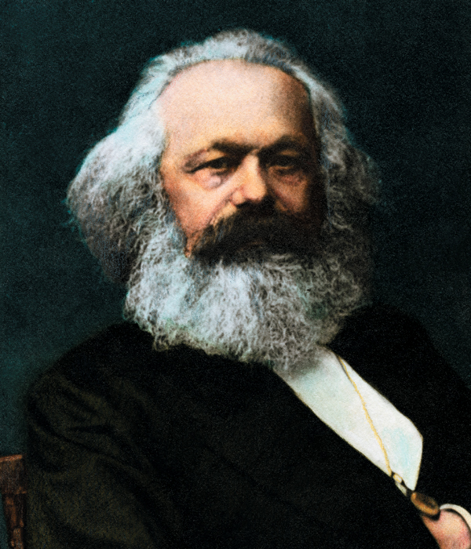
Karl Marx
Materialist conception of history: The view developed by Karl Marx according to which material or economic factors have a prime role in determining historical change.
For Marx, it is not the ideas or values human beings hold that are the main sources of social change, but economic influences.

Slide 22
Capitalism
Capitalism: An economic system based on the private ownership of wealth, which is invested and reinvested in order to produce profit.
The ruling class: Capitalists who own factories, machines, and large sums of money.
The working class: Wage workers who do not own the means of their livelihood but must find employment provided by the owners of capital.
According to Marx, capitalism is a class system in which conflict is inevitable.

Slide 23
Post-Capitalism
Marx imagined a future where societies would no longer be split into a small class that monopolizes economic and political power and a large mass of people who benefit little from the wealth their work creates.
His ideal economic system, while not eradicating all inequality, would be characterized by communal ownership and would lead to a more equal society than we know at present.

Slide 24
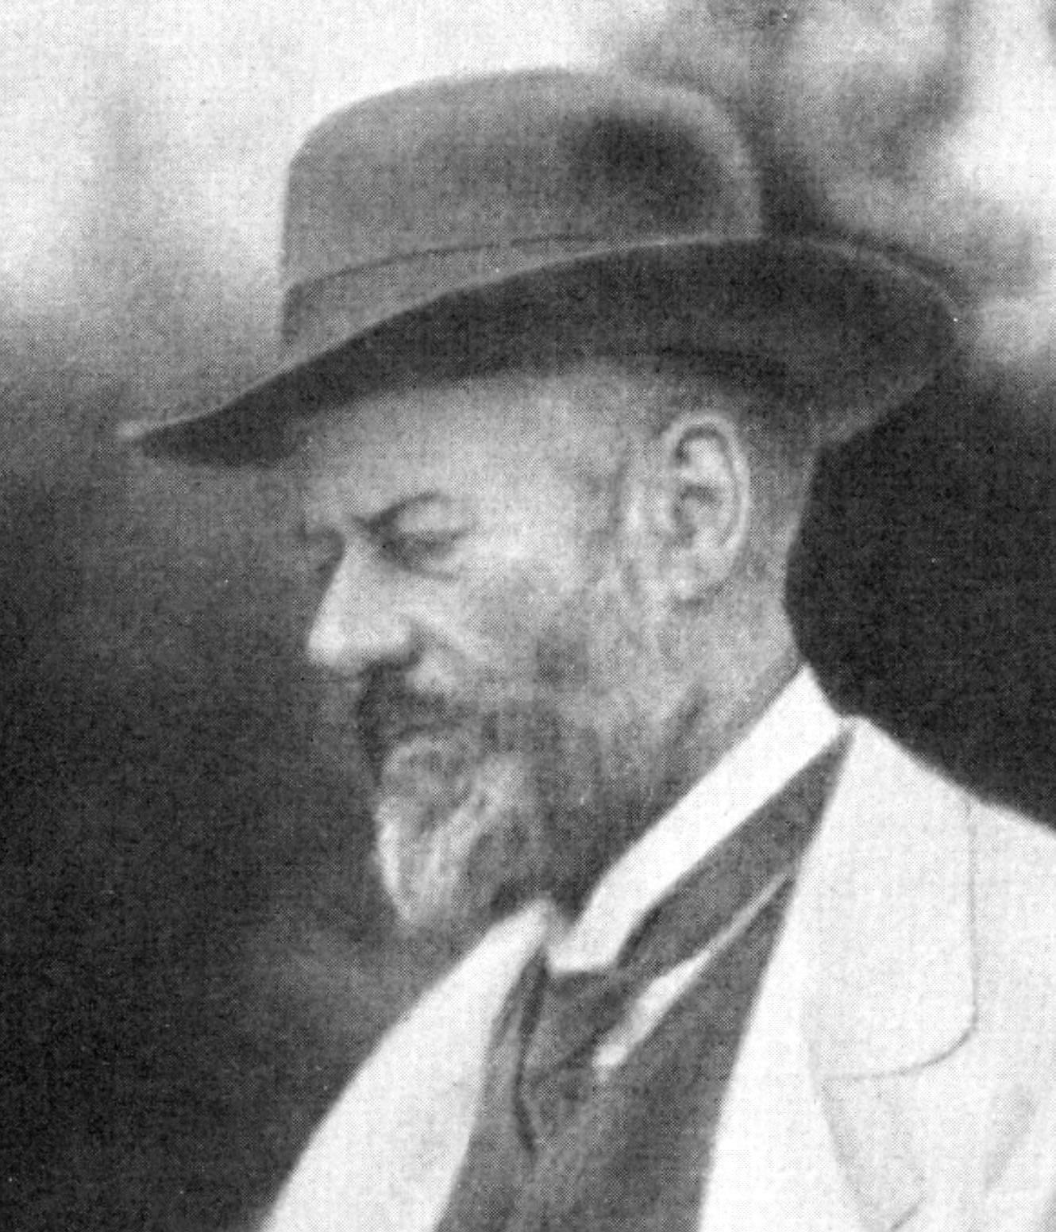
Max Weber
Max Weber was influenced by Marx, but he thought ideas and values were just as important for social change as economic factors.
He focused on why Western societies developed so differently from other societies, studying religion in particular.

Slide 25
Bureaucracy
Bureaucracy: A type of organization marked by a clear hierarchy of authority and the existence of written rules of procedure and staffed by full-time, salaried officials.
Weber saw the advance of bureaucracy as an inevitable feature of our era.
Bureaucracy enables large organizations to run efficiently, but it also poses problems for effective democratic participation in modern societies.
Experts make decisions without consulting those whose lives are affected by these decisions.

Slide 26
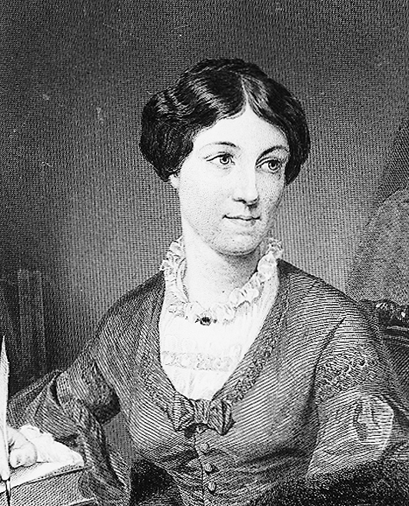
Harriet Martineau
Harriet Martineau has been called the “first woman sociologist.”
She was an active proponent of women’s rights and the abolition of slavery.
She is credited with introducing sociology to England through her translation of Comte’s Positive Philosophy.

Slide 27
Martineau’s Insights (1 of 2)
Martineau is significant to sociologists today for her methodological insights.
She argued that when one studies a society, one must focus on all its aspects, including key political, religious, and social institutions.
She also insisted an analysis of a society must include all its members, a point that emphasized the absence of women’s lives from the sociology of that time.

Slide 28
Martineau’s Insights (2 of 2)
Martineau was the first to turn a sociological eye on previously ignored issues and institutions, including marriage, children, domestic and religious life, and race relations.
She believed sociologists should do more than just observe; they should also act in ways that benefit society.

Slide 29
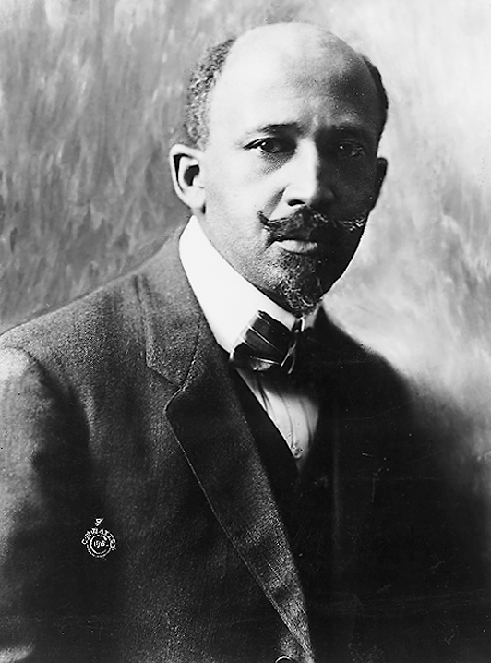
W. E. B. Du Bois
W. E. B. Du Bois was the first African American to earn a doctorate from Harvard University and a founding member of the National Association for the Advancement of Colored People (NAACP).
One of his most important sociological contributions is the idea of “double consciousness.”

Slide 30
Double Consciousness
Double consciousness describes the identity struggle felt by African Americans in an American society that only lets them see themselves through the eyes of others.
Du Bois claimed that one’s sense of self and one’s identity are greatly influenced by historical experiences and social circumstances.
In the case of African Americans, they were shaped by the effects of slavery, emancipation, segregation, and prejudice.

Slide 31
Race Relations
“The problem of the twentieth century is the problem of the color line.”
Du Bois was the first social researcher to link the problems faced by African Americans to social and economic causes.
This is a connection that most sociologists now widely accept.
He also connected social analysis to social reform.

Slide 32
Understanding the Modern World: The Sociological Debate
Marx’s ideas about capitalism continue to influence the economics of modern societies.
For every sociologist that has refined Marx’s ideas, there have been others, such as Max Weber, who offer alternative analyses.
Rationalization: A concept used by Weber to refer to the process by which modes of precise calculation and organization, involving abstract rules and procedures, increasingly come to dominate the social world.

Slide 33
1.3 Modern Theoretical Approaches

Slide 34
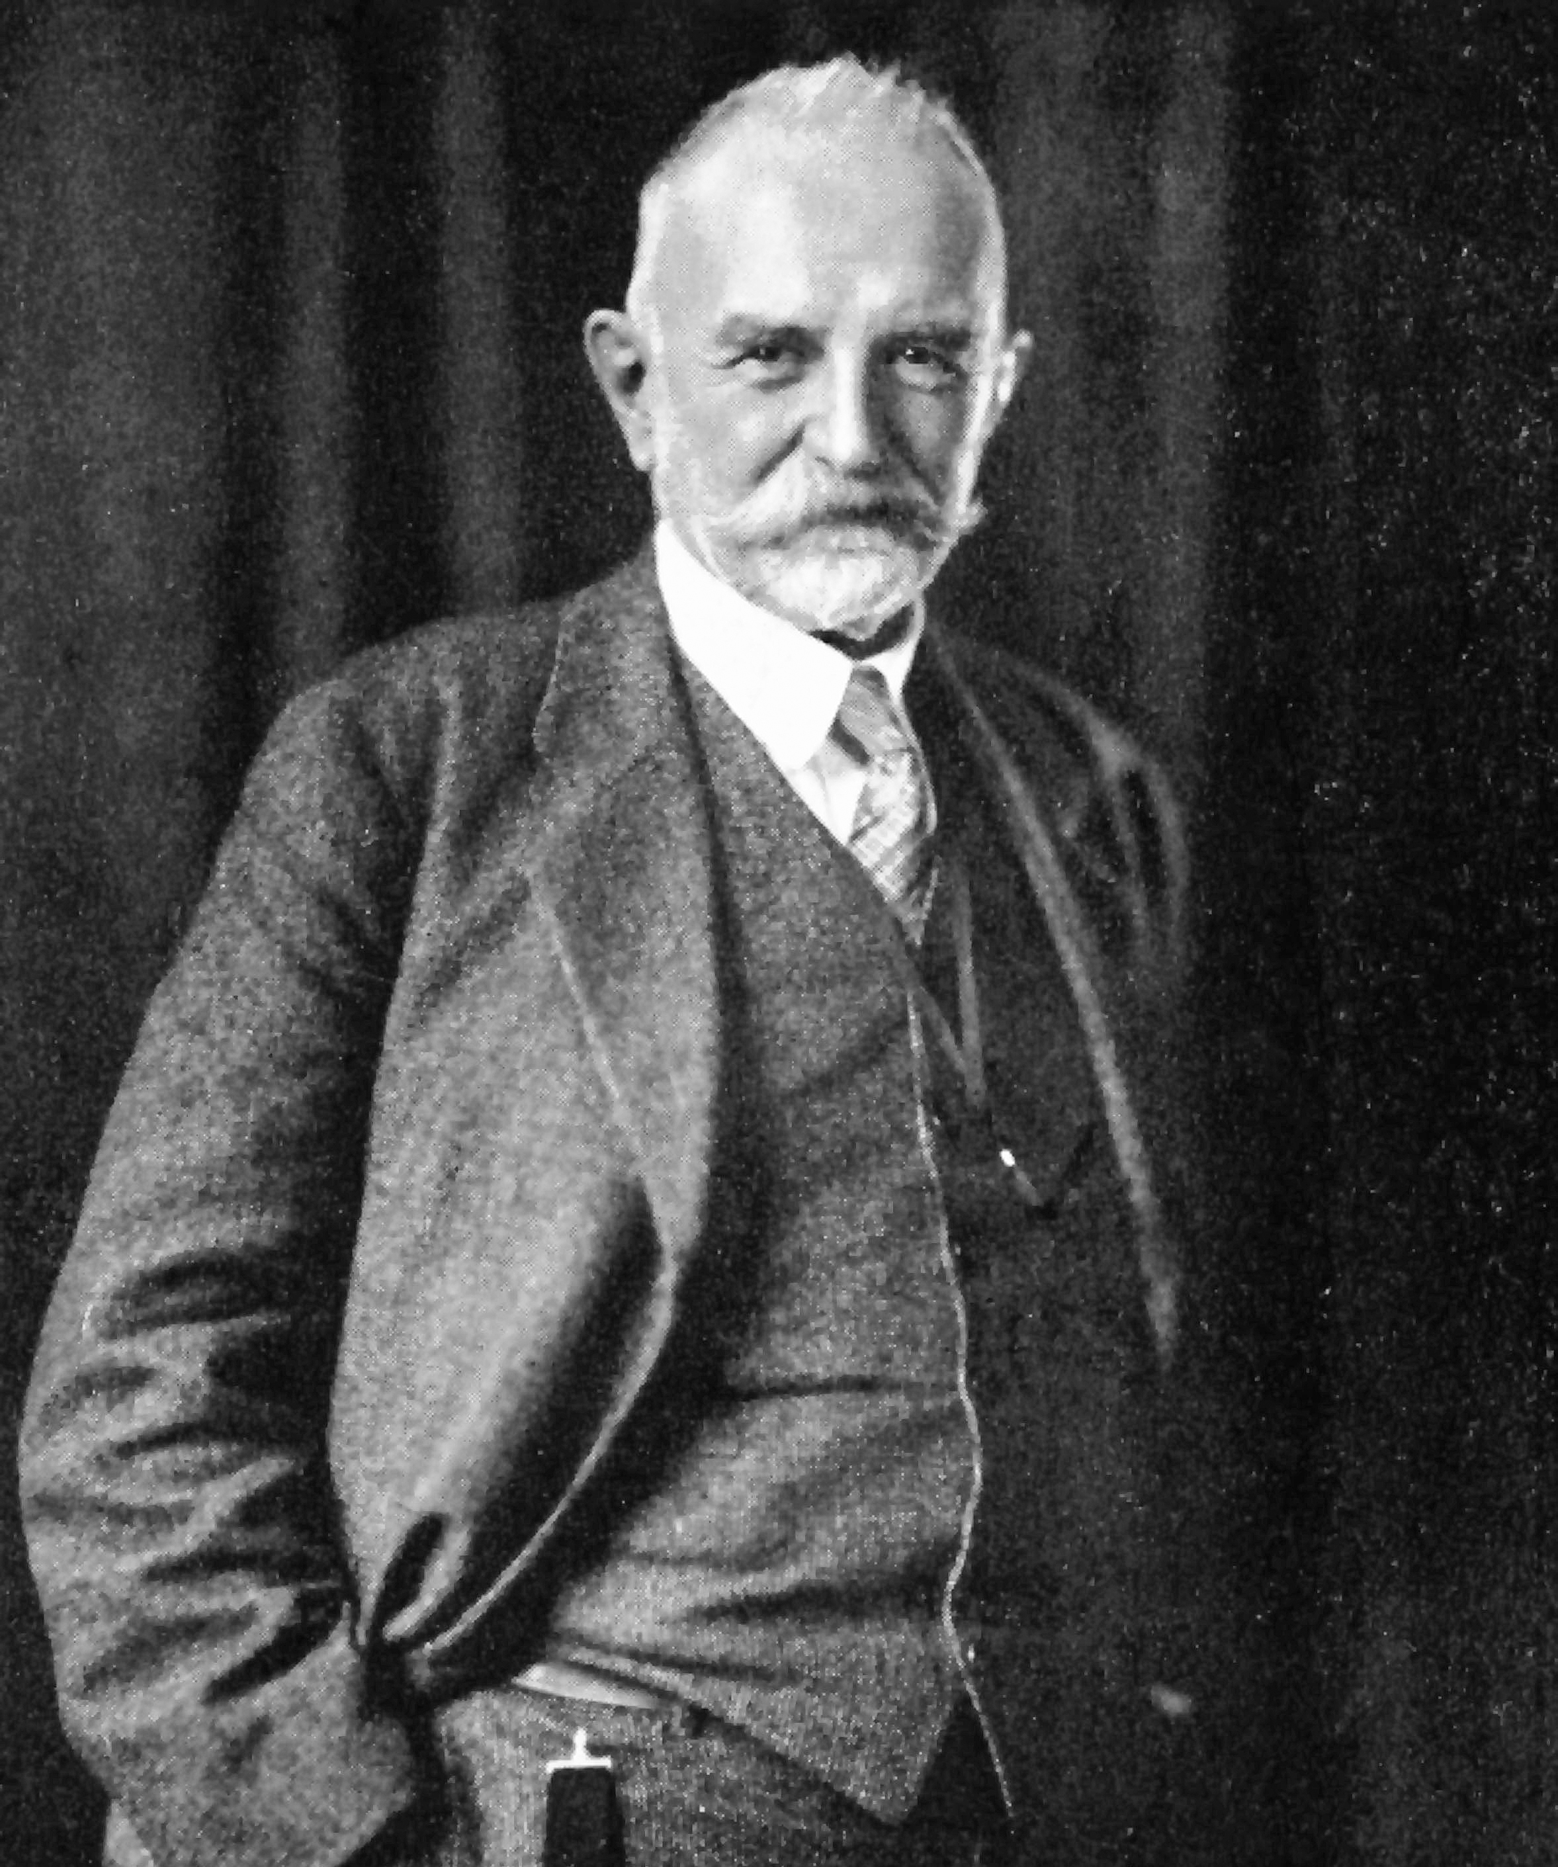
Symbolic Interactionism (1 of 2)
Symbolic interactionism: A theoretical approach developed by George Herbert Mead that emphasizes the role of symbols and language as core elements of all human interaction.
Symbol: One item used to stand for or represent another.

Slide 35
Symbolic Interactionism (2 of 2)
Mead argued that symbolic thought frees us from being limited in our experience to what we can actually see, hear, or feel.
In our interactions with others, we constantly look for context clues about appropriate behavior and interpret what others are up to.
Symbolic interactionism focuses on the detail of interpersonal interaction and how that detail is used to make sense of what others say and do.

Slide 36
Functionalism
Functionalism: A theoretical perspective based on the notion that social events can best be explained in terms of the functions they perform—that is, the contributions they make to the continuity of a society.
Functionalists regard order and balance as the normal state of society, and this social equilibrium is grounded in a moral consensus of shared values among the members of society.
Talcott Parsons and Robert K. Merton brought functionalism to prominence.

Slide 37
Merton’s Functions
Manifest functions: The functions of a type of social activity that are known to and intended by the individuals involved in the activity.
Latent functions: Functional consequences that are not intended or recognized by the members of a social system in which they occur.
Merton thought a major part of sociological explanation consisted in uncovering the latent functions of social activities and institutions.
He also distinguished between functions and dysfunctions.

Slide 38
Limitations of Functionalism
Functionalism was a leading theoretical tradition for most of the twentieth century, but its popularity has declined as its limitations became apparent.
Functionalist thinkers like Talcott Parsons unduly stressed factors leading to social cohesion at the expense of those producing division and conflict.
Many critics claim that functional analysis attributes to societies certain qualities they do not have.

Slide 39
Conflict Theories
Conflict theory: A sociological perspective that emphasizes the role of political and economic power and oppression as contributing to the existing social order.
Social order is believed to be maintained by domination, with power in the hands of those who possess the greatest political, economic, and social resources.
Marxism and feminist theories are typically classified as conflict theories.

Slide 40
Marxism
Marxism: A body of thought deriving its main elements from the ideas of Karl Marx. It differs from non-Marxist traditions of sociology in that its adherents view sociology as a combination of sociological analysis and political reform.
Marxism is supposed to generate a program of radical political change.
Marxists lay more emphasis on conflict, class divisions, power, and ideology than many non-Marxist sociologists.

Slide 41
Power
Power: The ability of individuals or the members of a group to achieve aims or further the interests they hold.
Power is a pervasive element in all human relationships.
Many conflicts in society are power struggles, because how much power an individual or group is able to achieve governs how far they are able to put their wishes into practice.

Slide 42
Ideologies
Ideologies: Shared ideas or beliefs that serve to justify the interests of dominant groups.
Ideologies are found in all societies in which there are systematic and ingrained inequalities among groups.
The concept of ideology connects closely with that of power, since ideological systems serve to legitimize the power that groups hold.

Slide 43
Feminist Theory
Feminist theory: A sociological perspective that emphasizes the centrality of gender in analyzing the social world and particularly the uniqueness of the experience of women.
There are many strands of feminist theory, but they all share the desire to explain gender inequality in society and to work to overcome it.
The prominence of feminist theory in contemporary sociology is notable because gender issues were scarcely broached by the major figures who established the discipline.

Slide 44
Feminism (1 of 2)
Feminism: Advocacy of the rights of women to be equal with men in all spheres of life.
Feminism dates from the late eighteenth century in Europe, and feminist movements exist in most countries today.
Like Marxism, feminism links sociological theory and political reform.

Slide 45
Feminism (2 of 2)
Feminist sociologists argue that women’s lives and experiences are central to the study of society.
They highlight gender relations and gender inequality as important determinants of social life, and emphasize that gendered patterns and gendered inequalities are not natural but socially constructed.
Today, feminist sociology focuses on the intersection of gender, race, and class.

Slide 46
Rational Choice Theory
Rational choice approach: A theory that posits that if you could have only a single variable to explain society, self-interest would be the best one.
It is derived from Weber’s categorization of “instrumental” behavior, which describes behavior oriented toward self-interest.
Within the field of criminology, rational choice analysis argues that deviant behavior is a rational response to a specific social situation.
Though this is a useful theoretical approach, it cannot explain everything.

Slide 47
Postmodern Theory
Postmodernism: The belief that society is no longer governed by history or progress.
Postmodern society is highly pluralistic and diverse, with no “grand narrative” guiding its development.
It is dominated by the new media, which “take us out” of our past, and everything seems constantly in flux.

Slide 48
Jean Baudrillard
One postmodern theorist, Jean Baudrillard, believed that electronic media created a chaotic, empty world.
He argued that meaning is created by the flow of images, as in TV programs, and that much of our world is now a make-believe universe in which we respond to media images rather than to real persons or places.

Slide 49
Theoretical Thinking in Sociology
Theoretical approaches are distinct from theories.
Theories are more narrowly focused and represent attempts to explain particular social conditions or types of events.
Theories are usually formed during the research process and suggest other problems for subsequent research.

Slide 50
Scales of Theoretical Thinking
Sociologists do not share a unified position on whether theories should be specific, wide-ranging, or somewhere in between.
Merton argued for middle-range theories, which are specific enough to be tested by empirical research, yet general enough to cover a range of phenomena.
Other theoretical schemes, like those in the Marxist tradition, are grander in scale.

Slide 51
Diversity in Theoretical Thinking
Assessing sociological theories and theoretical approaches is challenging.
Human behavior is complex, and no single theoretical perspective could adequately cover all its aspects.
Diversity in theoretical thinking provides a rich source of ideas for research and stimulates the imaginative capacities so essential to progress in sociological work.

Slide 52
Levels of Analysis
Microsociology: The study of human behavior in the context of face-to-face interaction.
Micro studies are necessary for illuminating broad institutional patterns.
Macrosociology: The study of large-scale groups, organizations, or social systems.
Macro analysis is essential for understanding the institutional background of daily life.

Slide 53
1.4 How Can Sociology Help Us?

Slide 54
How Can Sociology Help Us?
Sociology allows us to see the social world from many perspectives.
Sociology equips us with skills to assess the results of public-policy initiatives.
Sociology can provide us with self-enlightenment, or an increased sense of self-understanding.
Developing a sociological eye toward social problems and developing rigorous research skills opens many career doors.

Slide 55
Review Questions

Slide 56
Review Question #1
In sociology, studying the effects of the economic recession on a student’s ability to secure a job after graduation is a way of studying how ____ affects our lives.
the sociological imagination
our grades
social structure
our work ethic
Notes:
Answer: C
Social structure refers to the underlying regularities or patterns in how people behave and in their relationships with one another.
Although economic recessions may affect many people, there are patterns that dictate how strongly it affects different groups of people or different areas of employment.
These patterns may have a stronger affect on your ability to get certain jobs than individual decisions might.

Slide 57
Review Question #2
Many of the things we experience in life that seem to be completely natural, such as differences in behavior between men and women, are seen by sociologists to be examples of ____.
biology
social constructions
agency
division of labor
Notes:
Answer: B
Social constructions are ideas about the world that are created by man, rather than a result of pure biology or nature.
Differences in behavior between men and women, though often seen as a result of biology, are actually created through the different expectations of men and women expressed by members of a social group.

Slide 58
Review Question #3
Some sociologists argue that the current problems in America’s inner cities—such as drugs, violence, and fatherless households—are the result of the disappearance of blue-collar jobs in the United States. What idea does this argument reflect?
social constraint
rationalization of economic life
distinctiveness of Western society
materialist conception of history
Notes:
Answer: D
A materialist conception of history, developed by Marx, understands changes in society to have origins in economic factors.
Thus, social change is understood to originate in class struggles.

Slide 59
Review Question #4
A bureaucracy is a type of organization that depends on ____.
office buildings
the division of labor
social constraint
computer systems
Notes:
Answer: B
According to Weber, a bureaucracy is divided into different jobs with specific functions.
A bureaucracy essentially functions through organic solidarity, where the variety of specified tasks come together to create a functioning whole.

Slide 60
Review Question #5
The ability of individuals or members of a group to achieve aims or further their interests, even in the face of the resistance of others, is called ___.
determination
violence
power
ideology
Notes:
Answer: C
Although power may sometimes be based on violence or force, it is not the same thing.
Power is often accompanied by ideology, which can be used to obtain consent from others or to justify certain actions taken by the powerful.

Slide 61
Review Question #6
A study of university admissions that compares the impact of gender and social class on probability of admission before World War II and after World War II is an example of ___.
Marxism
macrosociology
functionalism
microsociology
Notes:
Answer: B
Macrosociology examines large-scale social systems and often looks at changes and/or continuities over time.
Although social class and gender are the properties of individuals, they have patterned impacts on institutions and other forms of social organization.

Slide 62
Discussion Questions

Slide 63
Discussion Question #1
Healthy older Americans often encounter exclusionary treatment when younger people assume they are feebleminded and thus overlook them for jobs they are fully capable of doing. How would functionalism and symbolic interactionism explain the dynamics of prejudice against the elderly?

Slide 64
Discussion Question #2
Coffee drinking is a cultural fixture that says as much about us as it does about the bean itself. Coffee is more than a simple product designed to quench a person’s thirst and fend off drowsiness. Discuss five sociological features of coffee consumption that show its “sociological” nature.

Slide 65
Credits
This concludes the Lecture PowerPoint presentation for Chapter 1 of Introduction to Sociology, 12th Seagull Edition.
For more resources, please visit: digital.wwnorton.com/introsoc12seagull

